Slide 1

Introduction to Flutter Benefits and Getting Started
Notes:
Hi There !
This could be the weirdest flutter tutorial you'd ever get, however it is what it is.
I'm trying to do what I love with the minimum effort to make my self comfortable and continue doing it, so I hope you like it. Or no, it doesn't matter :p I promise this tutorial will be a remarkable one, just hold on with me. Let's know about flutter more.

Slide 2


Notes:
Flutter is an open-source mobile application development framework created by Google. It's designed to help developers build beautiful, fast, and high-performance applications for any platform using a single codebase.

Slide 3
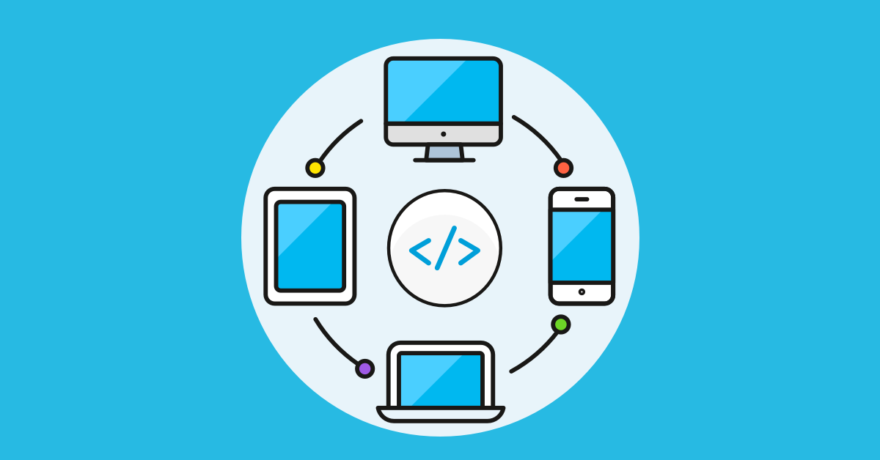
Dart
Flutter
Android Java
Web JS
Desktop C++/C
iOS Swift
Notes:
When I say development framework, this means that Flutter it's not a language, in fact Dart is the language behind Flutter. Flutter is just a framework used to convert your Dart code into other languages. So instead of learning Java, Swift, C++ or JavaScript, you just need to learn Dart, and Flutter will convert your code into these languages automatically and without any manual work from you, isn’t that great ? Yes it is.

Slide 4
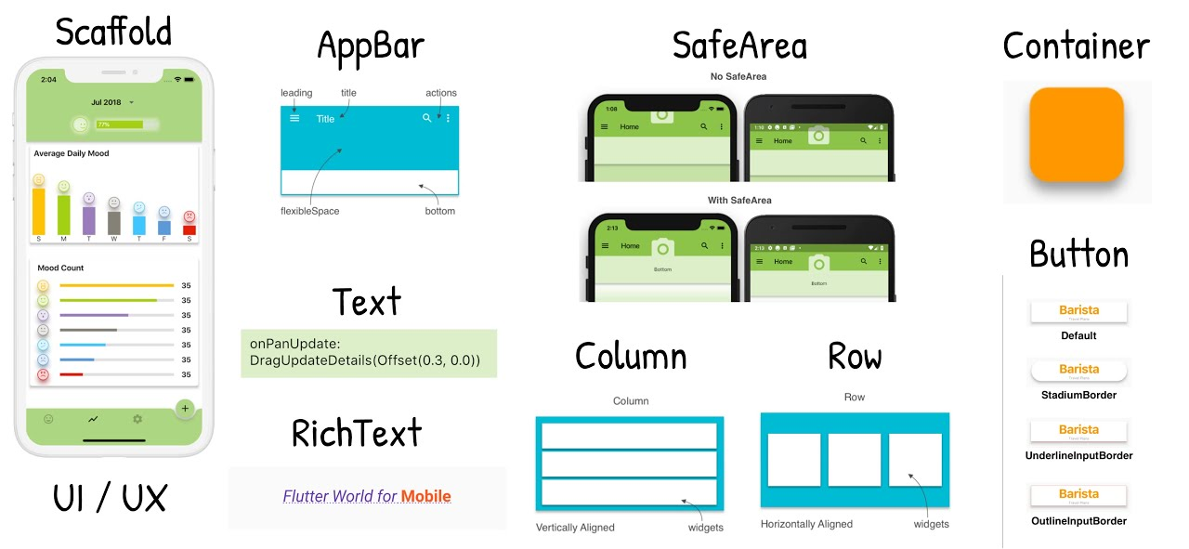
Notes:
With Flutter, you can create stunning user interfaces with customizable widgets, animations, and effects, those guys built everything under the hood, so that you can use it super easily without any effort.

Slide 5

Notes:
Now let’s get started

Slide 6
Notes:
That's a quick introduction to Flutter. Thanks for watching, and we'll see you in the next video!

